Slide 1
Dana +10 Workshop
April 11-13th 2012

Slide 2
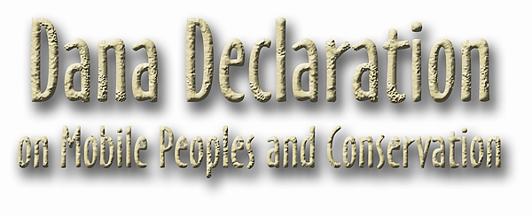
Notes:
www.danadeclaration.org A compromise document agreed between conservationists, social scientist and policy makers in Wadi Dana Jordan April 2002
Recognizing the unprecedented threats to conservation and the sustainable use of the word’s biodiversity …….. Mobile peoples are discriminated against, their rights , including access to natural resources are often denied and conventional conservation practices insufficiently address their concerns. Commitment to promoting the conservation practices based on the following principles:
I Rights to empowerment including rights to traditional land and resource rights.
II Trust and respect including accountability of conservation objectives and needs of mobile peoples
III Different knowledge systems acknowledging traditional and mainstream sciences and conservation management practices
IV Adaptive management building on areas of common interest between mobile lifestyles and sustainable resource management
Collaborative management including cross-cultural dialogue and decision making in conservation
World Parks Congress Recommendation 5.27 2003 creation of WAMIP
World Conservation Congress IUCN Bangkok 2004 Resolution 68 (with right to remain in Voluntary Isolation)
UNPFII fifth session 2006 side event to highlight the invisibility plight of MOBILE indigenous peoples
UNPFII seventh session 2008 – workshop on climate change and mobility peoples
World Conservation Congress IUCN Barcelona 2008 Resolution 126 Endorses Dana Declaration and recognizes the efforts of pastoral peoples as set out in the Segovia Declaration

Slide 3
www.danadeclaration.org
The Dana Declaration on Mobile Peoples and Conservation was the outcome of an agreed statement of concern and a compromise document promoting five principles of good practice between conservationists, social scientists and policymakers in Wadi Dana Jordan April 2002.

Slide 4
Dana Declaration on Mobile Peoples & Conservation
Recognizing the unprecedented threats to conservation and the sustainable use of the world’s biodiversity…
Mobile peoples are discriminated against, their rights, including access to natural resources are often denied and conventional conservation practices insufficiently address their concerns. We are hereby committed to promoting conservation practices based on the following five principles:

Slide 5
Principle I. Rights & Empowerment
Conservation approaches must recognize mobile peoples’ rights, management responsibilities and capacities and should lead to effective empowerment.
These include human rights, land and resource rights including under customary law; cultural and intellectual property rights, rights to full participation in decision-making and rights to derive equitable benefits from use of local natural resources.

Slide 6
Principle 2 . Trust and Respect
Partnerships with conservation interest should be based on mutual trust and address issues of discrimination.
These include equitable partnerships; acknowledgment and respect for mobile peoples institutions; recognition of customary law, accountability in relation to the fulfilment of conservation objectives and the needs of mobile peoples.

Slide 7
Principle 3. Different Knowledge Systems
Conservation of biodiversity needs to respect and incorporate mobile peoples traditional knowledge and management practices.
Complementary use of traditional and mainstream sciences is a valuable means of effecting two-way learning and meeting conservation dilemmas.

Slide 8
Principle 4. Adaptive Management
Adaptive management approaches should build on traditional / existing cultural models and incorporate mobile peoples worldviews, aspirations and customary law.
Such approaches should allow for diversity of livelihoods, systems of tenure, access to resources, and flexibility of management practices, with mobility as a central concept .

Slide 9
Principle 5. Collaborative Management
Should be based on the concept of equitable sharing of decision-making and management responsibilities once existing bodies become more democratic and transparent to allow for full and open participation of civil society and mobile peoples in particular.
This, for example, would then permit the fostering of locally agreed solutions to conservation problems, as well as a diverse and pluralistic approach to conservation planning.

Slide 10
Endorsements of the Dana Declaration
WPCA (World Commission on Protected Areas) IUCN Durban 2003 endorsement
Part of the Durban Action Plan (2003)
WAMIP formed at Durban WCPA (2003) and endorses the Dana Declaration
WCC (World Conservation Congress) of IUCN notes the Dana Declaration in 2004 Bangkok
WCC of IUCN endorses the Dana Declaration in 2008 Barcelona

