Slide 1
Why the Dana Declaration?
And why in Wadi Dana Jordan?
Dana +20 Workshop
7-10 September 2022

Slide 2
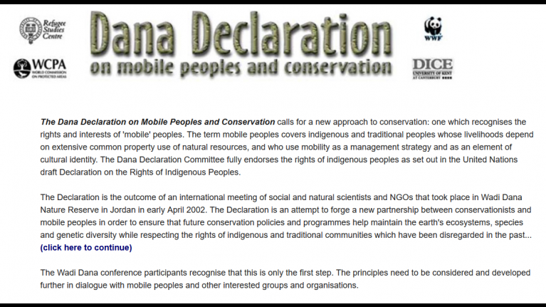
Why the Dana Declaration?

Slide 3
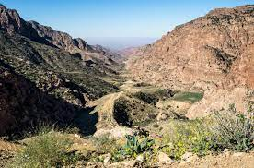
Why Wadi Dana?

Slide 4
Some history
Invisibility of Mobile Indigenous Peoples
The Brundtland Report. Our Common Future 1987
10 % of Earth's Surface to be declared protected areas

Slide 5
Some history (2)
Oxford Conference on Forced Settlement of Mobile Peoples 1999
Wadi Dana Conference 2002 sets out the Principles of the Dana Declaration
First endorsements from RSCN (2002) and WAMIP 2003 at WPC Durban

Slide 6
Entering soft International law
2023 5th World Parks Congress and Durban Accords
3rd World Conservation Congress the Dana Declaration is ‘noted’
2008 4th World Conservation Congress – Dana Declaration is endorsed as part of working principles for social development in the IUCN

Slide 7
Dana+10 in 2012
To apply the principles of the Dana Declaration to emerging issues such as climate change, multi-national extractive industry (petroleum and mining).
In partnership with WAMIP to further build the capacity of mobile indigenous peoples to take part in local, regional and international forums with regards to their basic human rights and land use

Slide 8
Dana+ 2020 2022
To reaffirm and to take stock of changes over the last 20 years
To encourage equal partnerships with delegates of Mobile Indigenous Peoples
To reach out to the numerous Mobile Peoples associations that have formed over the past 20 years
To produce a Dana +20 statement and Action Plan leading up to IYRP in 2026.

