Slide 1

Trends in conservation policy and practice over the past 20 years
Helen Newing
Global policy on protected areas is decided at the World Parks Congresses
which are organized by the World Commission on Protected areas
which is one of several Commissions of the International Union for the Conservation of Nature (IUCN).
Notes:
Call to commitments to involve and benefit local communities, indigenous and mobile peoples in protected areas that affect them, with full respect of their rights.

Slide 2
The Durban Accord: The ‘New Paradigm’ for protected areas:
Helen Newing
“We need a fresh and innovative approach to protected areas and their role … equitably integrating them with the interests of all affected people”.
Included calls to involve and benefit indigenous and mobile peoples in the creation, proclamation and management of protected areas, with full respect for their rights.
Notes:
Call to commitments to involve and benefit local communities, indigenous and mobile peoples in protected areas that affect them, with full respect of their rights.

Slide 3
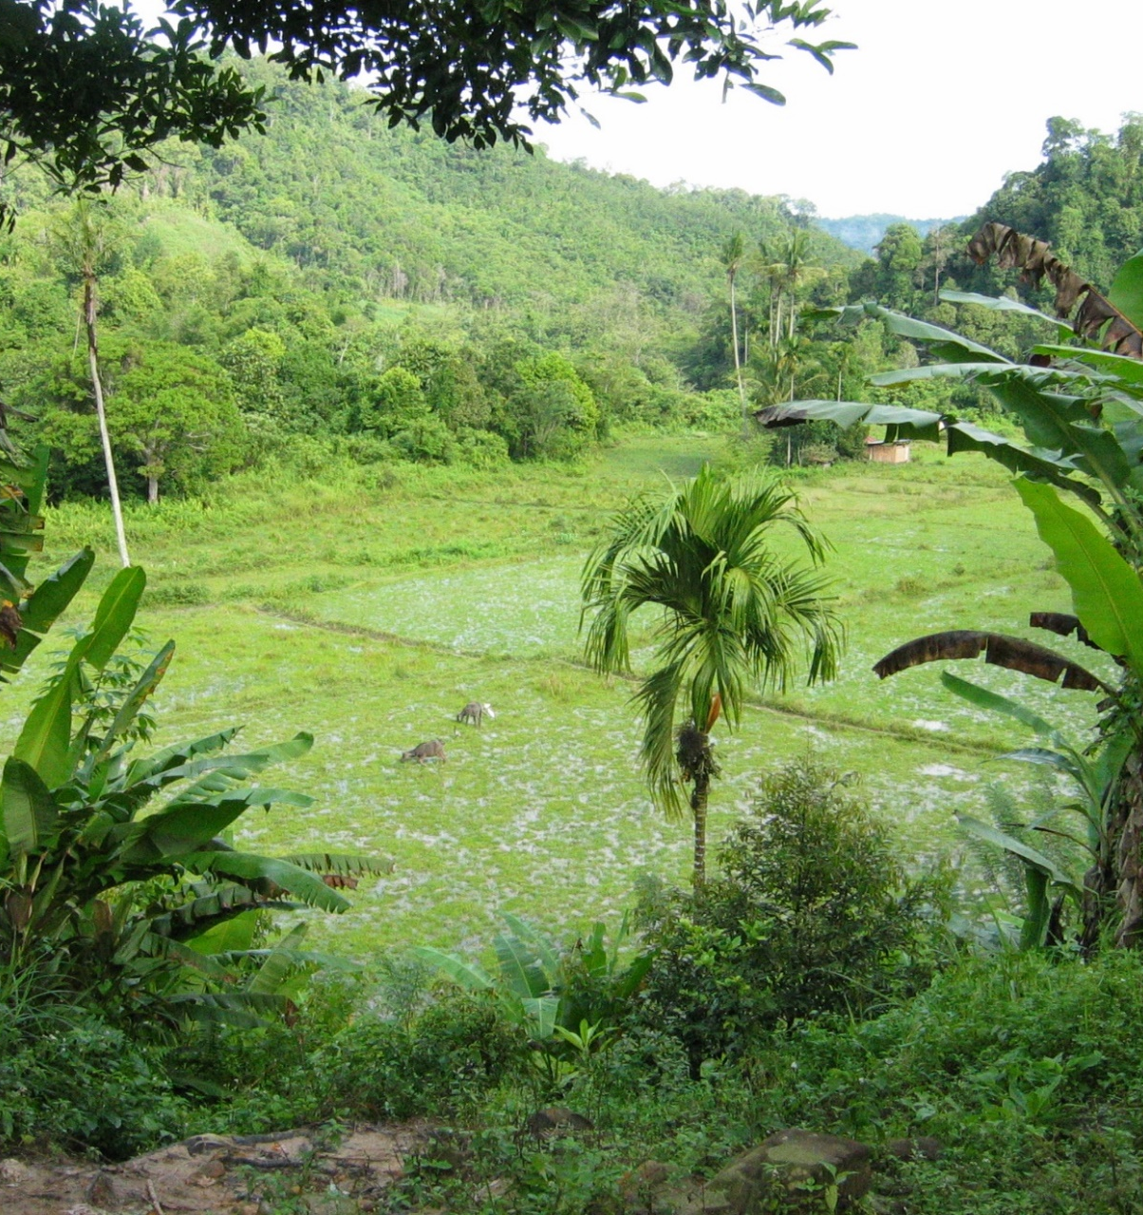
The introduction of new protected areas ‘governance’ categories
A. State protected areas
B. Co-managed protected areas
C. Private protected areas
D. Protected areas governed by Indigenous peoples and local communities (ICCAs)

Slide 4
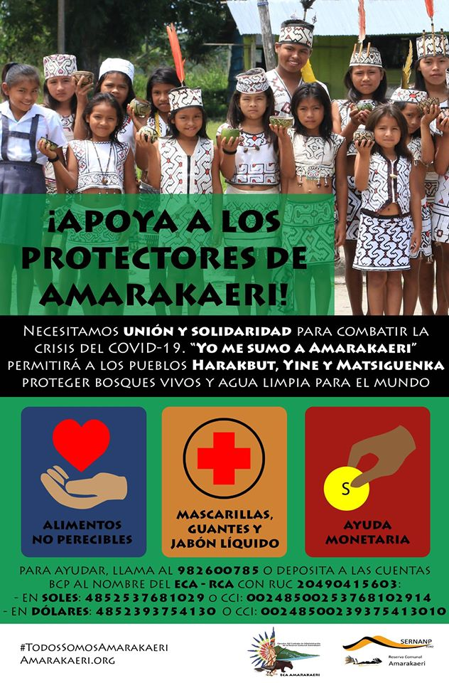
What this has meant in practice: new mechanisms developed in many countries for legal designation of ICCAs
Communal reserves in Peru: Protected areas “managed by and for the benefit of neighbouring populations”

Slide 5
The Conservation Initiative on Human Rights (2009)
“We, the undersigned international conservation organizations, reaffirm our commitment to:
Respect internationally proclaimed human rights and make sure that we do not contribute to infringements of human rights
Promote human rights within conservation programmes
Protect the vulnerable
Support the improvement of governance systems that can secure the rights of indigenous peoples and local communities in the context of our work”

Slide 6
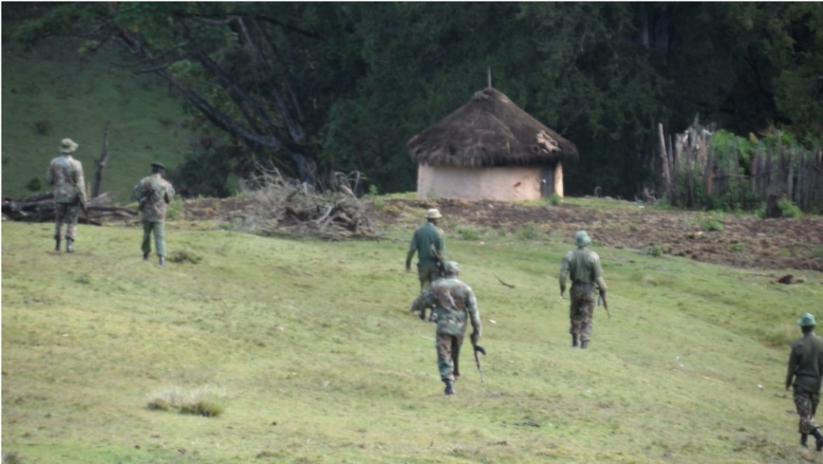
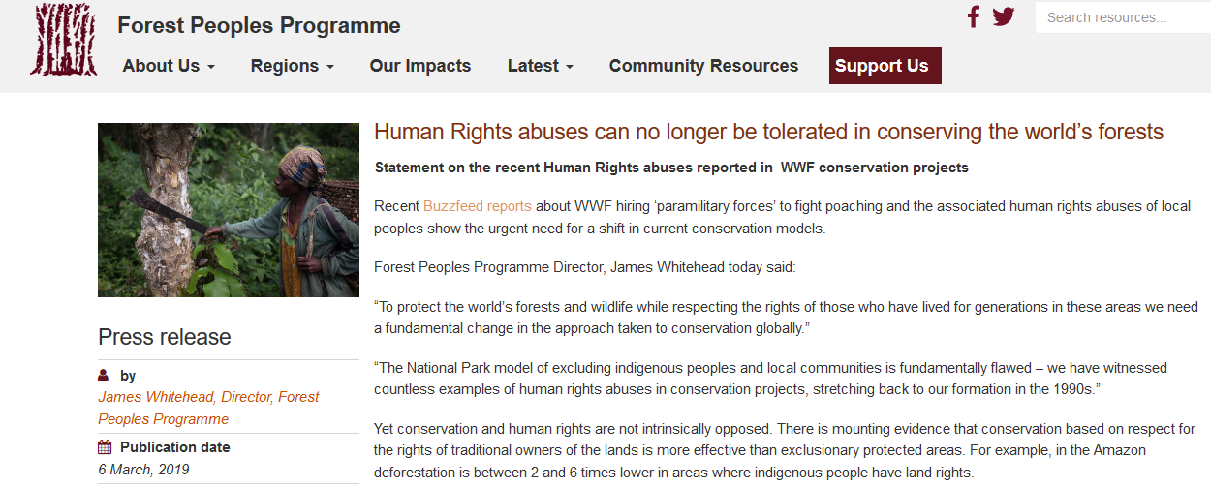
And yet, human rights abuses continue
Credit: Yator Kiptum

Slide 7
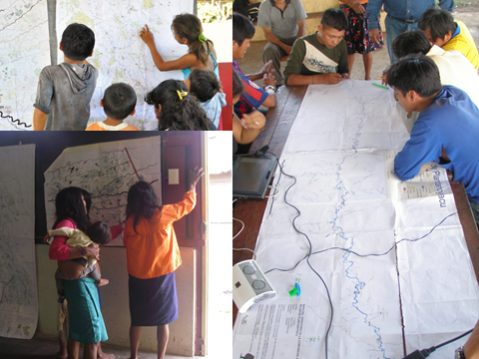
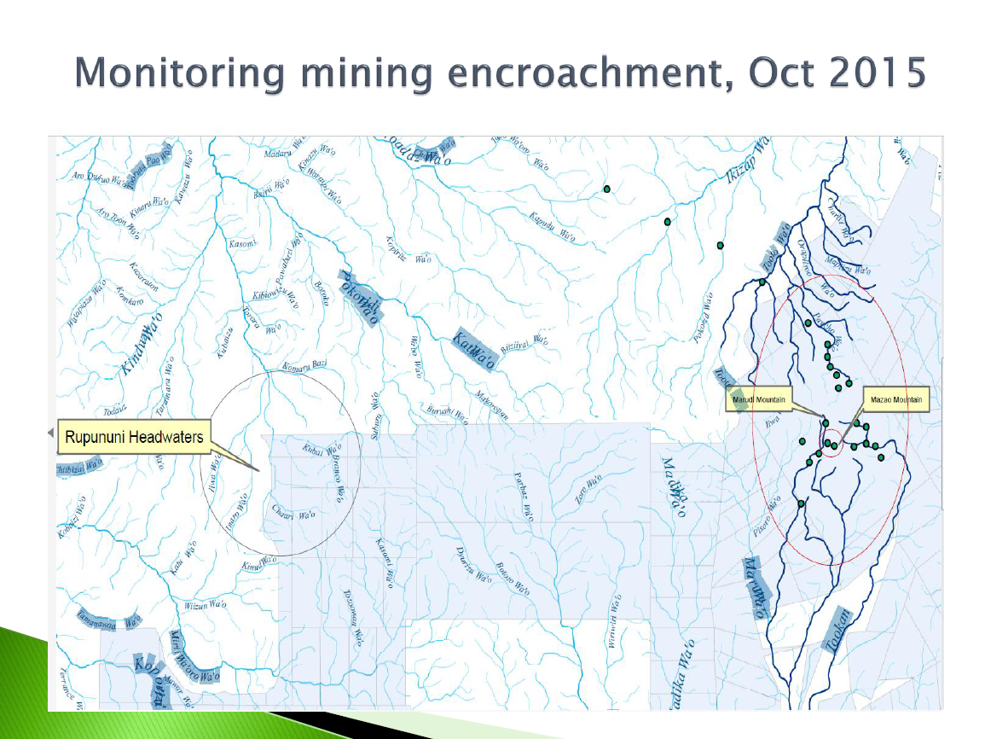
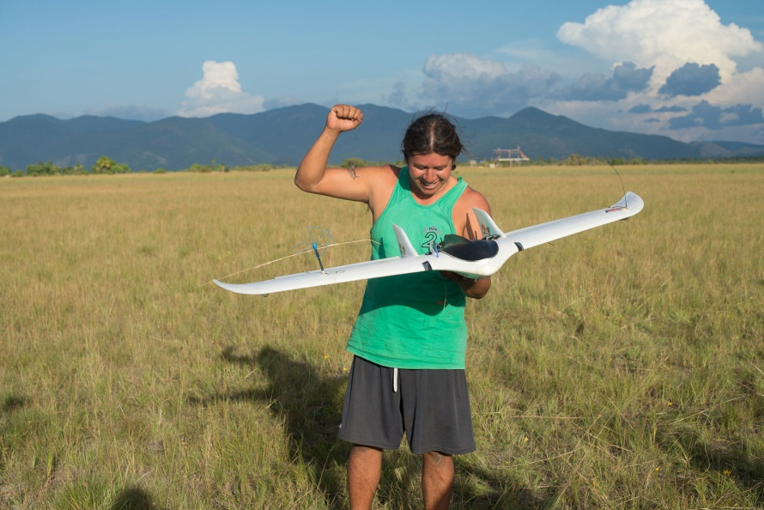
Indigenous peoples take the initiative to defend their lands
Notes:
Pic from FECONAU, Peru

Slide 8
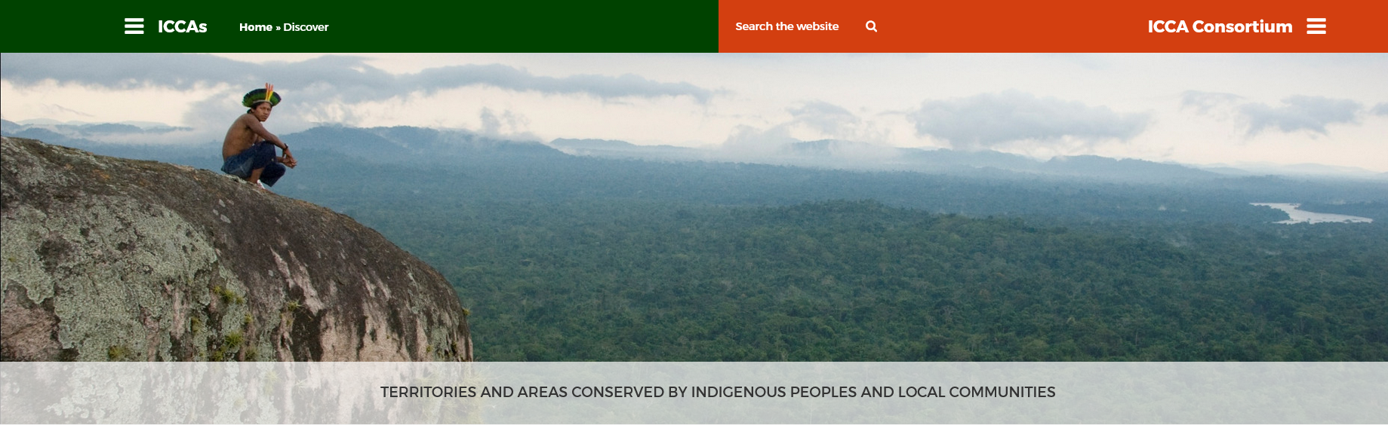
The ICCA Consortium
https://www.iccaconsortium.org/

Slide 9
The Convention on Biological diversity and the draft post-2020 Global Biodiversity Framework
Recognition of the contributions of indigenous peoples / traditional knowledge systems
Much broader in scope than IUCN
Language on rights
“By 2030, protect and conserve through well connected and effective system of protected areas and other effective area-based conservation measures at least 30 percent of the planet with the focus on areas particularly important for biodiversity.”
Target 3 of the draft post-2020 Global Biodiversity Framework

Slide 10
Ways forward; what is needed?
Recognition of rights and accountability
Building on common ground locally and nationally
Documenting and communicating achievements and contributions
Notes:
Conservationists traditionally focus on protected areas, but it is now widely recognized that there needs to be a wider approach to conservation than this.

Slide 11
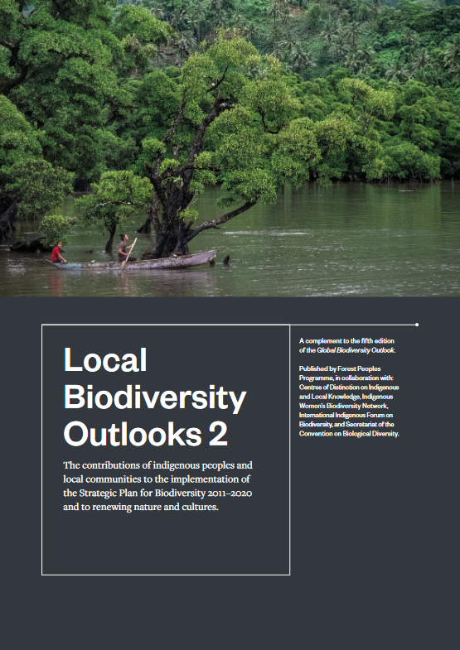
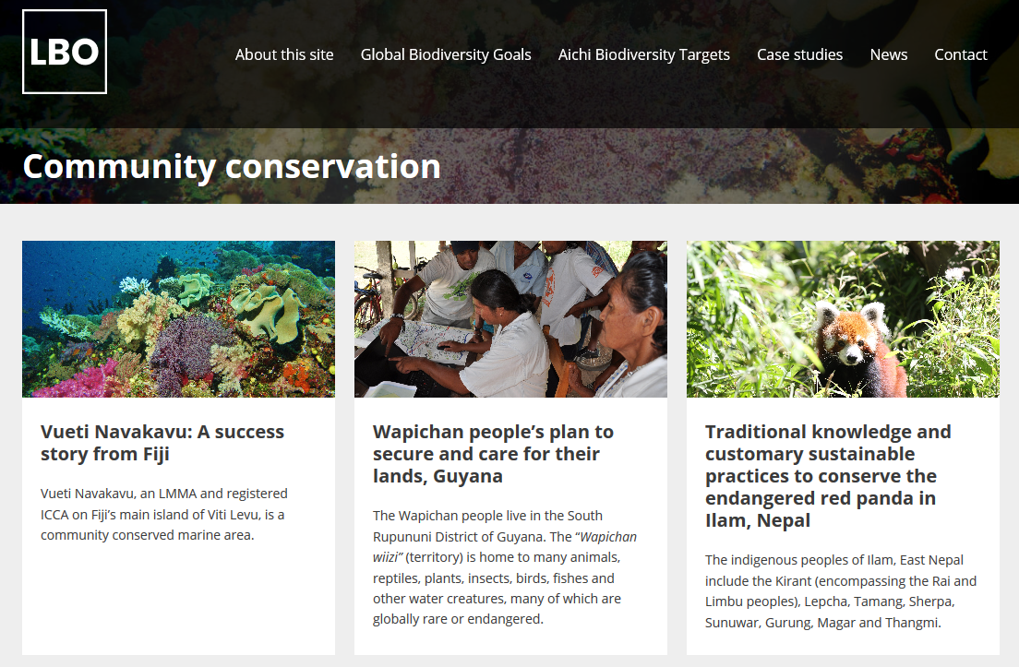
https://localbiodiversityoutlooks.net/

Slide 12
What is a protected area?
“A clearly defined geographical space, recognised, dedicated and managed, through legal or other effective means, to achieve the long-term conservation of nature with associated ecosystem services and cultural values”
Since 1992: Six management categories – from strict nature reserves to sustainable use areas

Slide 13

Three characteristics identify an ICCA:
There is a close connection between the area and an indigenous people or local community.
2. The people or community makes and enforces decisions and rules about the area.
3. These decisions, rules and actions contribute to the conservation of nature (ecosystems, habitats, species, natural resources).

Slide 14
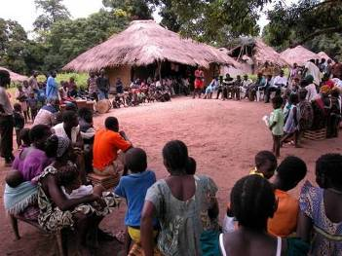
Potential synergies: some ways forward
Protected areas and indigenous peoples
Effective safeguarding
Move from overwhelming emphasis on state protected areas to indigenous and community conserved areas / OECMs
New targets on equity and indigenous governance
Indigenous territories and biodiversity
Secure land tenure and support for territorial defence
Greater support for indigenous conservation and sustainable land use
Better understanding of the enabling conditions for indigenous conservation
¹ OECD (2019) Biodiversity: Finance and the economic business case for action. https://www.oecd.org/environment/resources/biodiversity/G7-report-Biodiversity-Finance-and-the-
Economic-and-Business-Case-for-Action.pdf. Cited in LBO2. Aichi Biodiversity Target 3 focuses on reform of incentives. ²Rights and Resources Initiative (2015) Who owns the world’s land? A global baseline of formally recognized indigenous and community land rights. https://rightsandresources.org/wp-content/uploads/GlobalBaseline_web.pdf.

